Slide 1



Slide 2
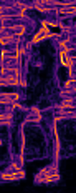
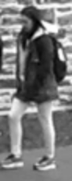

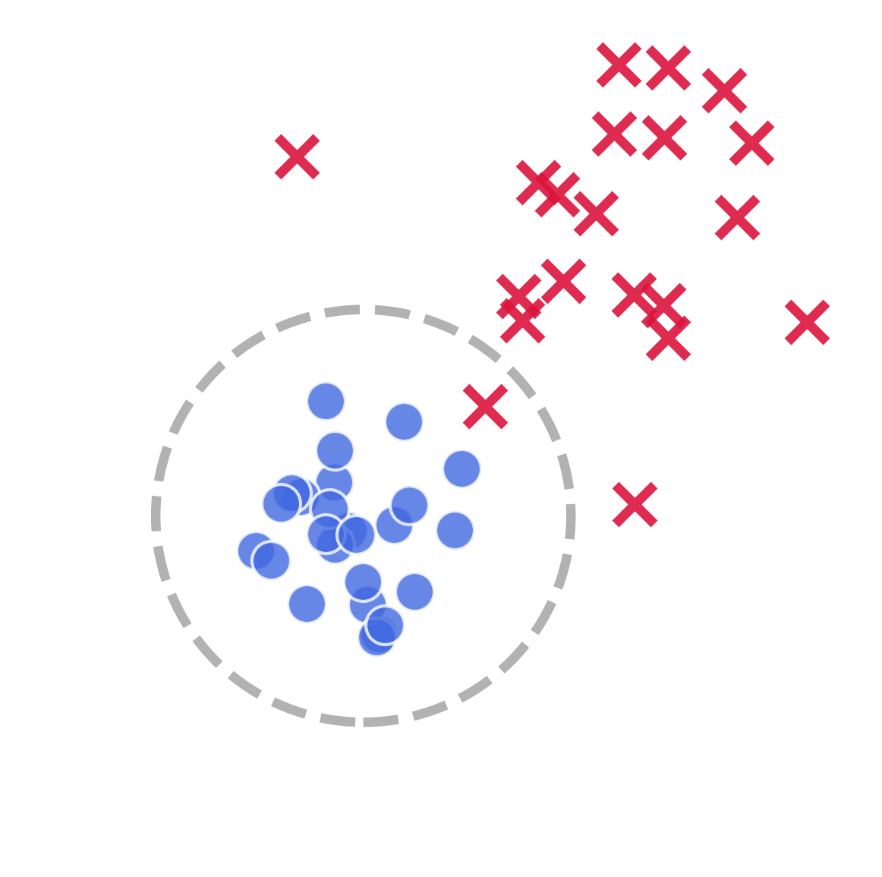



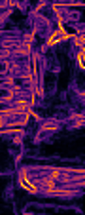
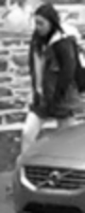

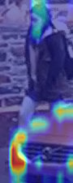
High-Freq
Low-Freq
Global State
Metric Space Collapse
Details
Structure
Holistic
Ideal Manifold
Global State
Local State
High-Freq
Low-Freq
Local State
Attention
Occlusion Noise
Topology Intact
Occluded
Token Drift

Slide 3
High-Freq
Low-Freq
Global State
(b) Metric Space Collapse
Details
Structure
Holistic
Ideal Manifold
Global State
High-Freq
Low-Freq
Local State
Local State
Attention
Frequency-Blind Transformer
Occlusion Noise
Topology Intact
Occluded
(c) Token Drift
(a) Spectral Bimodality

Slide 4
High-Freq
Low-Freq
Global State
(b) Metric Space Collapse
Details
Structure
Holistic
Ideal Manifold
Global State
High-Freq
Low-Freq
Local State
Local State
Attention
Frequency-Blind Transformer
Occlusion Noise
Topology Intact
Occluded
(c) Attention Distraction
(a) Spectral Bimodality

Slide 5
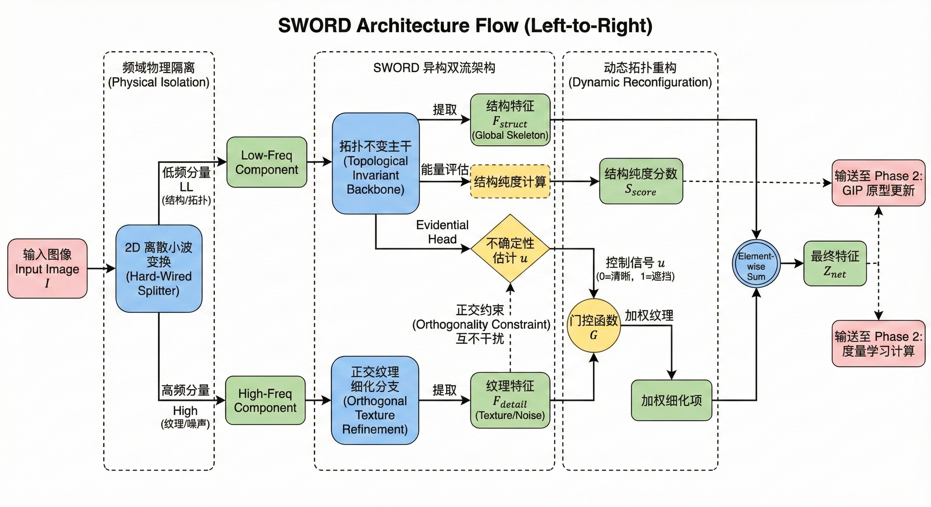

Slide 6
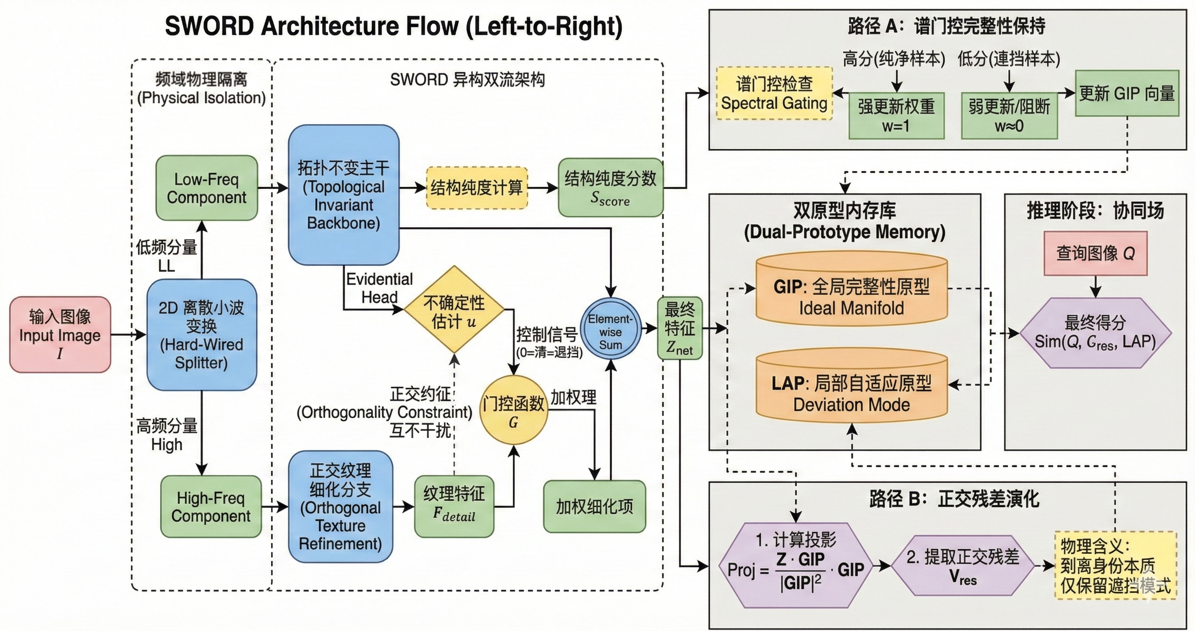

Slide 7
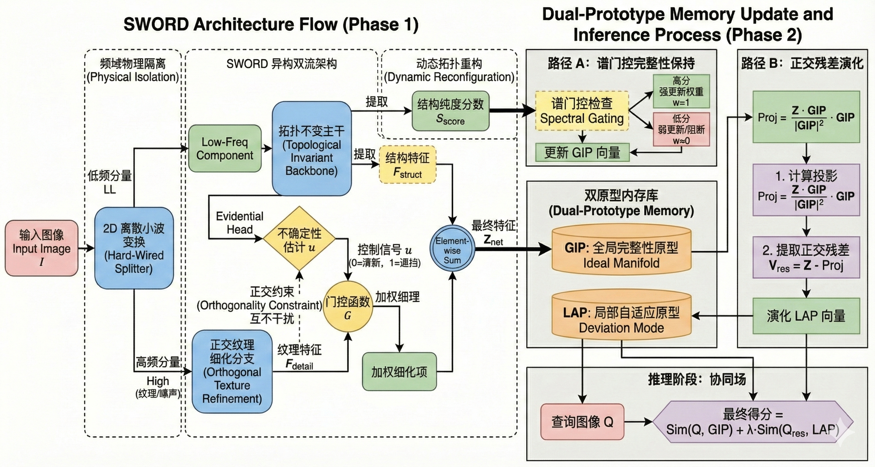
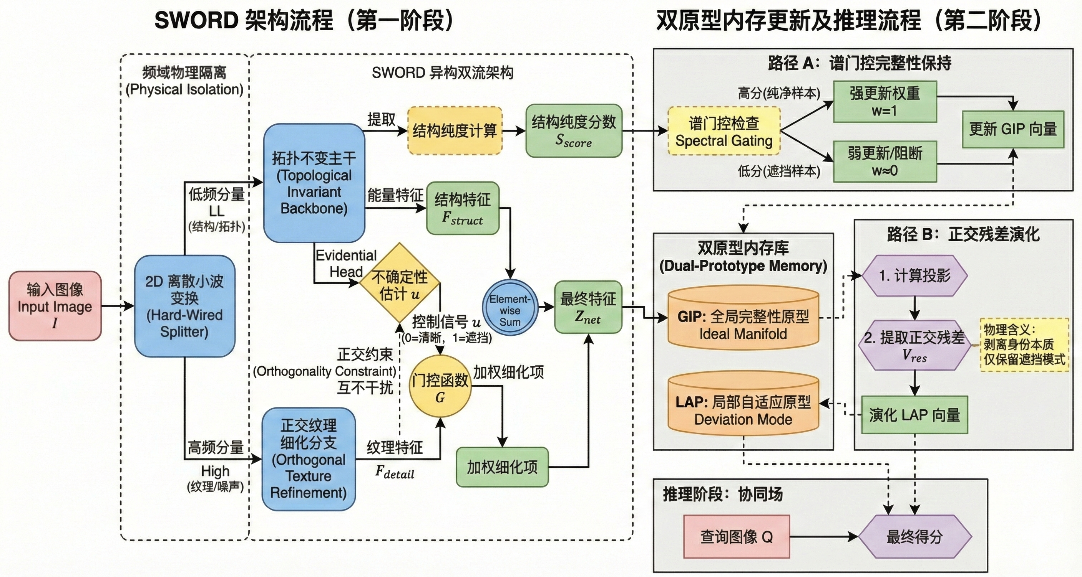
Orthogonality Constraint

Slide 8
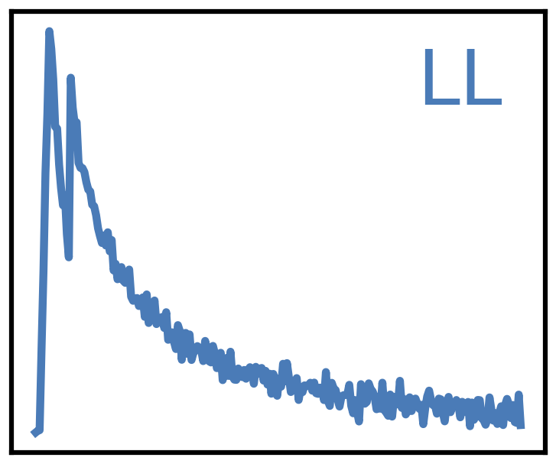
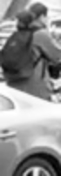

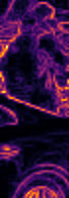
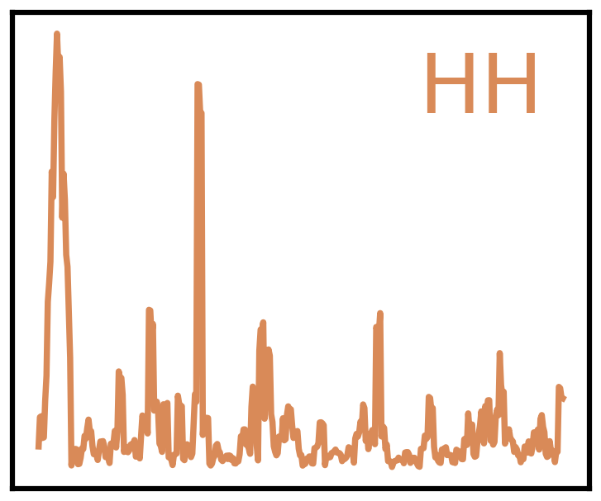
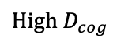
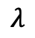
SG-DM
ADORE
LF component
Spectral Gating
TIB
Structure Calculator
$${High D}_{cog}$$
Weak Update/
Block
Strong Update
Hard-Wired Splitter
Estimate
GIP
Ideal Manifold
=
u(0/1)
project
OTRB
Residual Extractor
w
evolution
HF component
LAP
Deviation Mode
$$λ$$
Score
Spectral Wavelet Orthogonal Refinement Disentanglement (SWORD)
Structural Feature
Detail Feature (occlusion and texture)
Weighted Fine-Grained Feature
Output Feature
=
Evidential Head
Gating Function
Element-Wise Sum
Orthogonality Constraint
Structural Purity Score

Slide 9
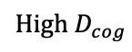
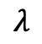
Spectral Wavelet Orthogonal Refinement Disentanglement (SWORD)
SG
ADORE
LF component
Spectral Gating
TIB
Structure Calculator
$${High D}_{cog}$$
Weak Update/
Block
Strong Update
Hard-Wired Splitter
Estimate
GIP
Ideal Manifold
=
u(0/1)
project
OTRB
Residual Extractor
w
evolution
HF component
Orthogonality Constraint
LAP
Deviation Mode
$$λ$$
Score
=
Evidential Head
Gating Function
Element-Wise Sum
Structural Purity Score
Structural Feature
Detail Feature
Weighted Feature
Output Feature

Slide 10
Spectral Wavelet Orthogonal Refinement Disentanglement (SWORD)
SG
ADORE
LF component
Spectral Gating
TIB
Structure Calculator
$${High D}_{cog}$$
Weak Update/
Block
Strong Update
Hard-Wired Splitter
Estimate
GIP
Ideal Manifold
=
u(0/1)
project
OTRB
Residual Extractor
w
evolution
HF component
Orthogonality Constraint
LAP
Deviation Mode
$$λ$$
Score
=
Evidential Head
Gating Function
Element-Wise Sum
Structural Purity Score
Structural Feature
Detail Feature
Weighted Feature
Output Feature

Slide 11
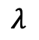
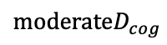
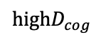
Spectral Wavelet Orthogonal Refinement Disentanglement (SWORD)
SG
ADORE
LF component
Spectral Gating
TIB
Structure Calculator
$${highD}_{cog}$$
Cognitive Divergence
Weak Update/
Block
Strong Update
Hard-Wired Splitter
Estimate
GIP
Ideal Manifold
=
u(0/1)
project
OTRB
Residual Extractor
w
evolution
HF component
$$moderateD_{cog}$$
LAP
Deviation Mode
$$λ$$
Score
=
Evidential Head
Gating Function
Element-Wise Sum
Structural Purity Score
Structural Feature
Detail Feature
Weighted Feature
Output Feature
Orthogonality Constraint

Slide 12
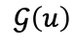
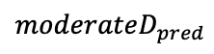
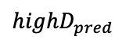
Frequency-Disentangled Architecture (FDA)
SCG
Orthogonal Dual-Prototype Learning (ODPL)
LF component
Spectral Gating
SB
Structure Calculator
$$highD_{pred}$$
Prediction Divergence
Weak Update/
Block
Strong Update
Spectral Bifurcation Module
Estimate
GIP
Ideal Manifold
=
u
project
DB
Residual Extractor
$$𝒢\left(u\right)$$
learning
HF component
$$moderateD_{pred}$$
LRP
Deviation Mode
$$λ$$
Score
=
Evidential Head
Gating Function
Element-Wise Sum
Structural Purity Score
Structural Feature
Detail Feature
Weighted Feature
Output Feature
Orthogonality Constraint

Slide 13
SG
ADORE
LF component
Spectral Gating
TIB
Structure Calculator
$${High D}_{cog}$$
Weak Update/
Block
Strong Update
Hard-Wired Splitter
Estimate
GIP
Ideal Manifold
=
u(0/1)
project
OTRB
Residual Extractor
w
evolution
HF component
LAP
Deviation Mode
$$λ$$
Score
Spectral Wavelet Orthogonal Refinement Disentanglement (SWORD)
Structural Feature
Detail Feature (occlusion and texture)
=
Evidential Head
Gating Function
Element-Wise Sum
Output Feature
Weighted Fine-Grained Feature
Orthogonality Constraint
Structural Purity Score

Slide 14
SG-DM
ADORE
LF component
Spectral Gating
TIB
Structure Calculator
$${High D}_{cog}$$
Weak Update/
Block
Strong Update
Hard-Wired Splitter
Estimate
GIP
Ideal Manifold
=
u(0/1)
project
OTRB
Residual Extractor
w
evolution
HF component
LAP
Deviation Mode
$$λ$$
Score
Spectral Wavelet Orthogonal Refinement Disentanglement (SWORD)
Structural Feature
Detail Feature (occlusion and texture)
=
Evidential Head
Gating Function
Element-Wise Sum
Output Feature
Weighted Fine-Grained Feature
Orthogonality Constraint
Structural Purity Score

Slide 15

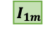
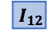
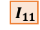
LF component
Spectral Gating
query
TIB
Structure Calculator
Weak Update/
Block
Strong Update
Projector
Hard-Wired Splitter
Estimate
GIP
Ideal Manifold
=
u(0/1)
project
OTRB
Residual Extractor
evolution
HF component
LAP
Deviation Mode
$$λ$$
Score
$${ I}_{11}$$
$${ I}_{12}$$
…
$${ I}_{1m}$$

Slide 16
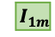
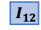
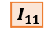
F_struct
LF component
TIB
Structure Calculate
Hard-Wired Splitter
Hard-Wired Splitter
Estimate
F_detail
=
calculate
u(0/1)
OTRB
HF component
$${ I}_{11}$$
$${ I}_{12}$$
…
$${ I}_{1m}$$

Slide 17
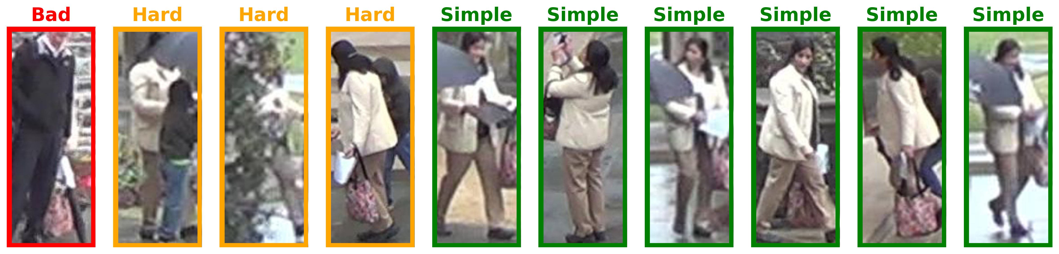
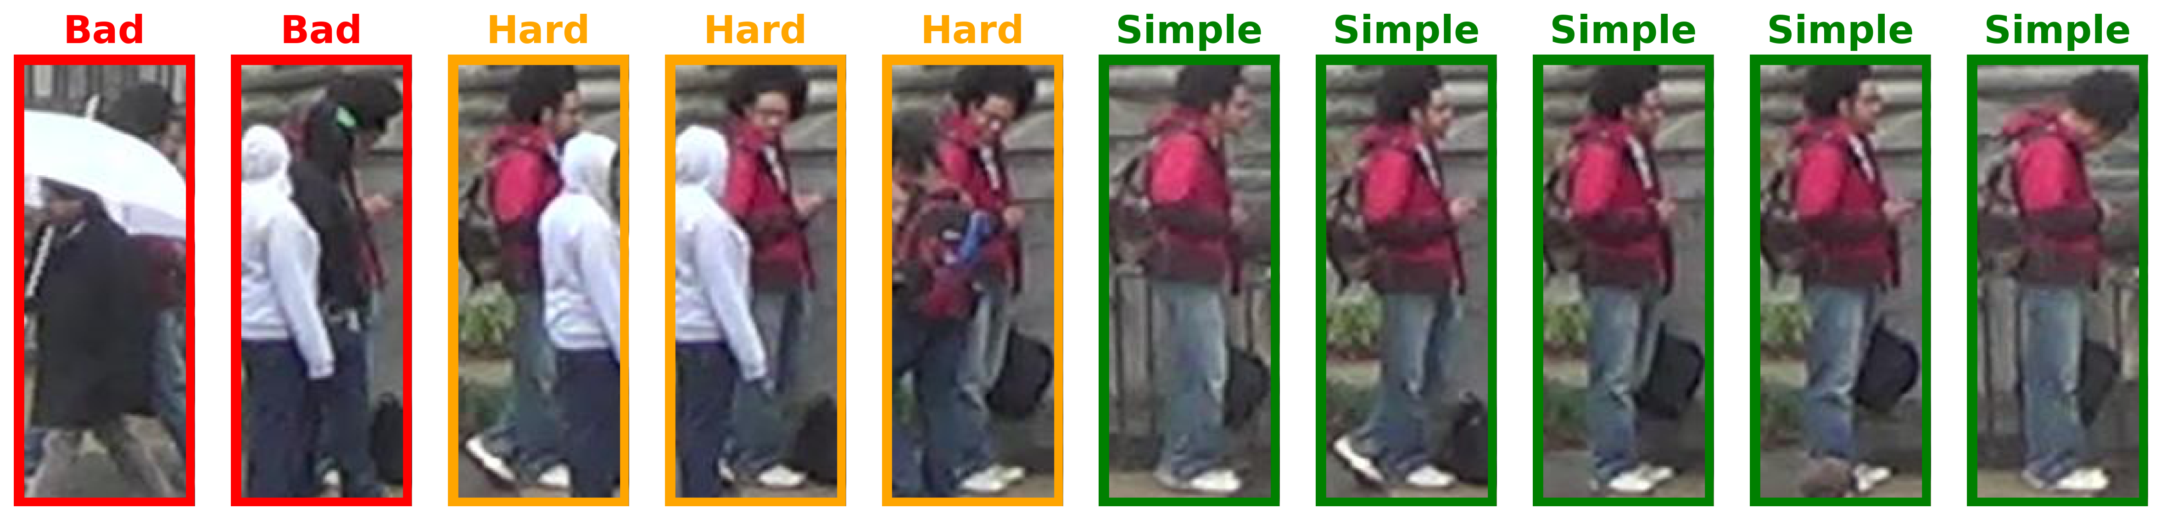
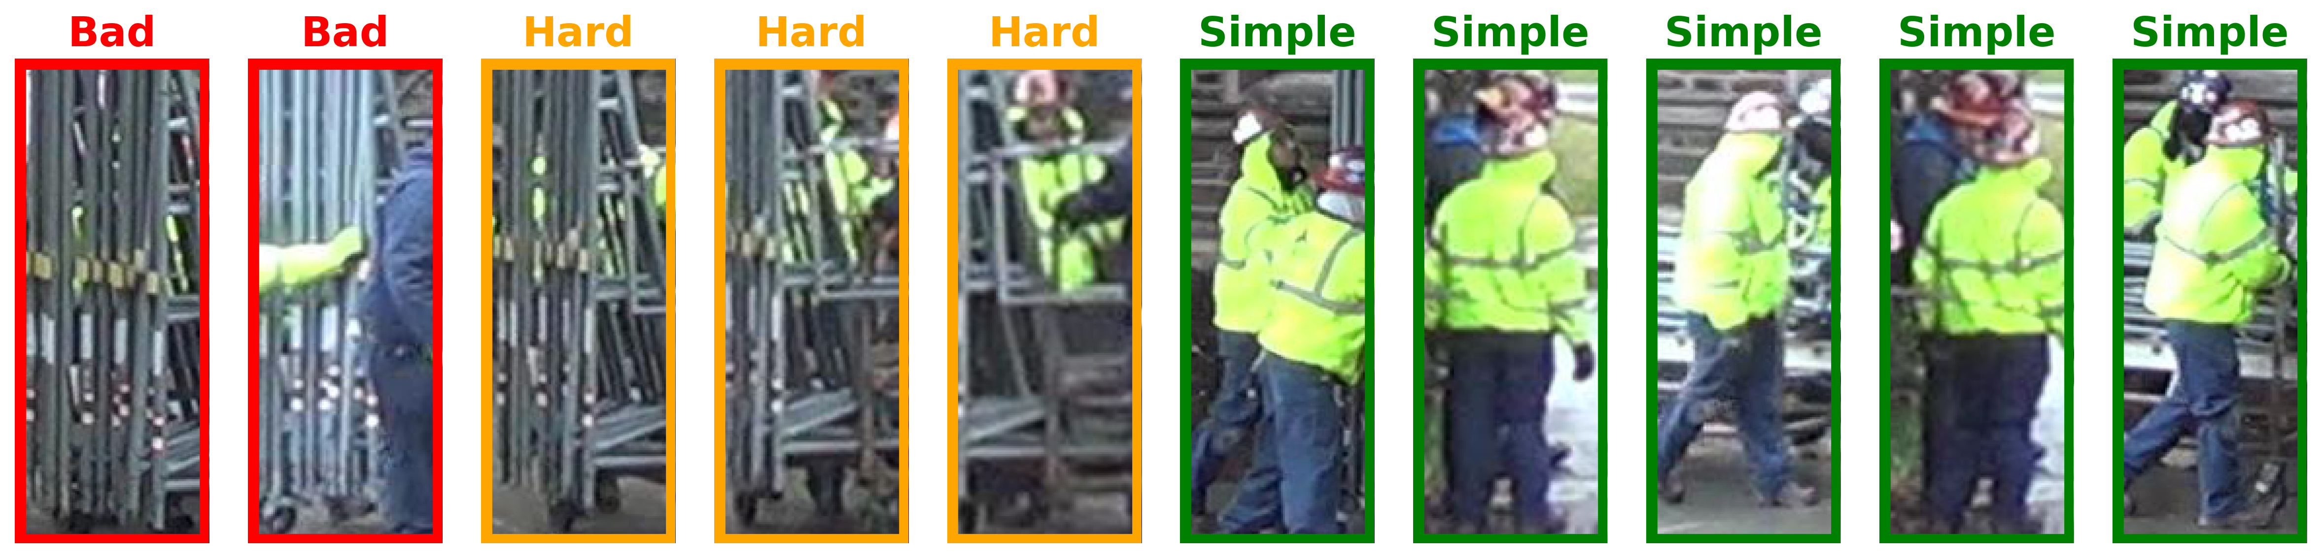
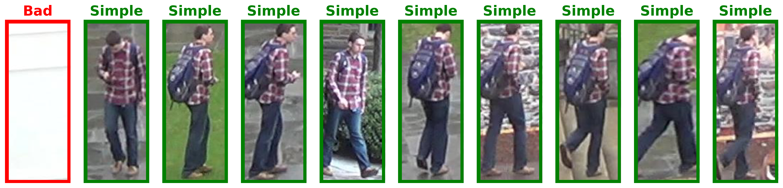
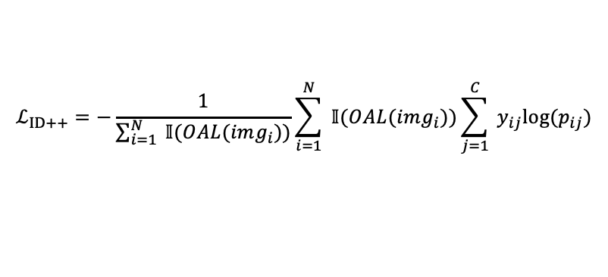
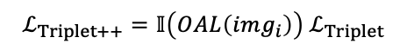
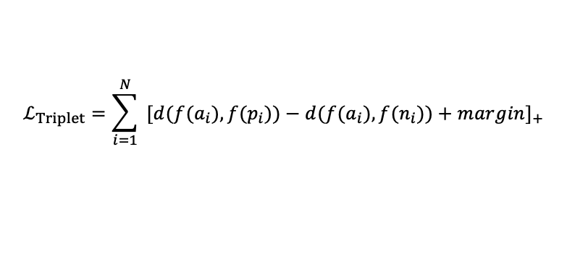
OAL(MLLM)
Occlusion Severity Estimation
OAL(MANUAL)
PC Verification
Single Subject Detection
Self-guided
Single Analysis
Target Identification
guide
Occlusion Severity Assessment
ID:0014
OAL
Module
Mixed Loss Function
ID:0224
$$ℒ_{ID++}=−\frac{1}{\sum_{i=1}^{N}{ }𝕀(OAL(img_{i}))}\sum_{i=1}^{N}{ }𝕀(OAL(img_{i}))\sum_{j=1}^{C}{ }y_{ij}log⁡(p_{ij})$$
ID:3765
$$ℒ_{Triplet}=\sum_{i=1}^{N}{ }[d(f(a_{i}),f(p_{i}))−d(f(a_{i}),f(n_{i}))+margin]_{+}$$
Weighted
Fusion
Any
Re-ID Module
$${ I}_{11}$$
$${ I}_{12}$$
…
$${ I}_{1m}$$
$${ I}_{21}$$
$${ I}_{22}$$
…
$${ I}_{2m}$$
ID:0798
$$\text{…}$$
$$\text{…}$$
…
…
$$ℒ_{Triplet++}=𝕀\left(OAL\left(img_{i}\right)\right) ℒ_{Triplet}$$
$${ I}_{n1}$$
$${ I}_{n2}$$
…
$${ I}_{nm}$$
$${ I}_{1,1}$$
$${ I}_{1,2}$$
…
$${ I}_{1,m}$$
Feature Vector
Bad Sample (Incorrect)
Bad Sample (Severely Occluded)
Hard Sample (Partially Occluded)
Simple Sample (Correct)
Notes:
不只用直线，用曲线和折线；在分类模块的流程加上注释；修改Filter Module的名字；右上角加上损失函数的图，介绍损失函数
左下角的图将边框加粗，右上角画手工分类的流程，与大模型分类相对应 加上图注：左下角红框是bad

Slide 18
HF component
LF component
TIB
F_struct
Hard-Wired Splitter
OTRB
HF component

Slide 19
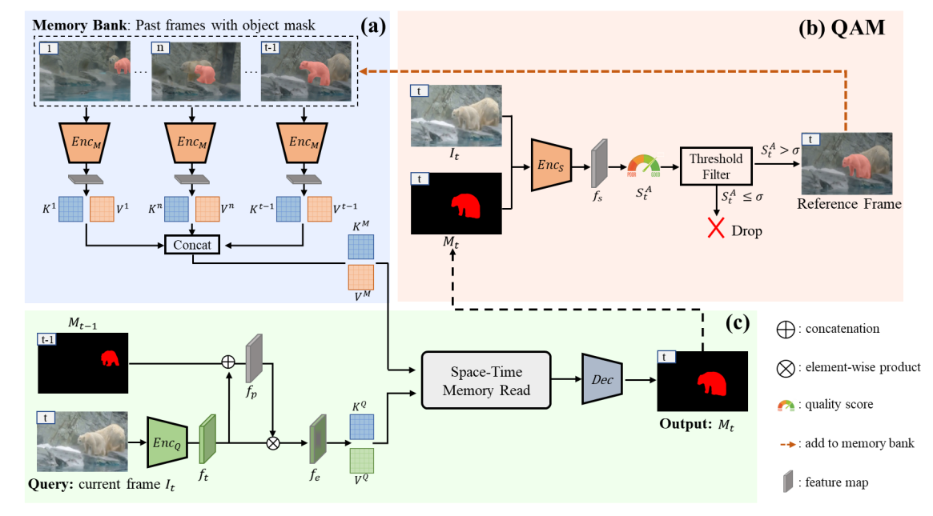
$${ I}_{11}$$
$${ I}_{12}$$
…
$${ I}_{1m}$$
$${ I}_{21}$$
$${ I}_{22}$$
…
$${ I}_{2m}$$
$$\text{…}$$
$$\text{…}$$
…
…
$${ I}_{n1}$$
$${ I}_{n2}$$
…
$${ I}_{nm}$$

